Slide 1

DEPARTMENT OF COMPUTER SCIENCE AND ENGINEERING
Industrial Oriented Mini Project On
MULTIPLE DISEASE PREDICTION USING MACHINE LEARNING
Presented By BATCH-03 :
Guide & HOD :
Mr. P. RATHAIAH (M.Tech,Sr.Assist.Prof)
N.SINDHUJA (20631A0549)
M.RAAM SAI BHARADWAJ (20631A0538)
G.SAI VINAY (20631A0544)
V.SAI CHARAN (20631A0542)

Slide 2
Contents
Abstract
Existing Systems & Disadvantages
Proposed Systems & Advantages
System Requirements
System Architecture
Modules
Algorithms
Data Flow Diagram
UML Diagrams
Output Screenshots
Conclusion
Reference

Slide 3
Abstract
The Multiple Disease Prediction System using Machine Learning is an advanced healthcare application that utilizes machine learning algorithms to accurately predict the likelihood of a patient having multiple diseases based on their medical history and symptoms.
We are using machine learning techniques such as decision trees, support vector machines, and random forests.
Ultimately, the Multiple Disease Prediction System using Machine Learning has the potential to improve healthcare outcomes and reduce healthcare costs by predicting and preventing disease early.

Slide 4
Existing System
S. No | Description | Dataset | Accuracy
1 | Disease Prediction System. International Research Journal of Engineering and Technology. | Data Collected from Local Hospitals and Open Sources. | Random Forest Performed well compared to Naive Bayes and Decision Tree.
2 | Heart Disease Prediction with Machine Learning Approaches . International Journal Of Science and Research . | Dataset obtained from Cleveland Heart Disease database at UCI Repository. | Highest Accuracy achieved by kin with 87%.
3 | Heart Attack Prediction By Using Machine Learning Techniques . International Journal Of Recent Technology and Engineering . | Dataset Obtained from UCI Repository . | Highest Accuracy achieved by SVM 89.34%.

Slide 5
Disadvantages of the Existing Model
Limited accuracy: While machine learning algorithms and other advanced techniques have
improved the accuracy of disease prediction models, they are still subject to errors and false
positives.
Limited availability: Disease prediction models may not be widely available or accessible to
healthcare providers, especially in low-resource settings or in areas with limited technological
infrastructure. This can limit the potential impact of these models on population health.
Privacy concerns: Disease prediction models may require access to sensitive patient data, raising
concerns about patient privacy and the security of this information.

Slide 6
Proposed System
Along with the increased accuracy rate, we will proliferate the reliability of our system for this job and can gain the trust of patient in this system.
Apart from all these, our system will comprise of a Database for storing the data entered by the users and the name of the disease the patient is suffering from which can be used as a reference in future for further treatment.
Hence this system will contribute in easier health management with better satisfaction to the users.

Slide 7
Advantages of the Proposed Model
We Provide a comprehensive and integrated system that can predict multiple diseases accurately.
It would provide a unified platform for disease prediction, saving users time and efforts in accessing separate models for each disease.
It uses Supervised Machine Learning Algorithms to enhance accuracy.

Slide 8
System Requirements
Software Requirements
Hardware Requirements
Programming Language : Python
IDE : Jupyter Notebook
Library’s for Data Manipulation : Pandas
Library’s for Data Analysis : NumPy
Library’s for Data Visualization : Matplotlib
Processor : Intel i5 or Above
RAM : 8GB or Above
Storage : 500GB or Above

Slide 9
System Architecture
Decision Tree
Random Forest
Training Set
ML Algorithms
Naïve Bayes
Disease Dataset
K-Nearest Neighbor
Randomly Divided
Testing Set
Test Model
Model
Learn Model
Performance
Predict Disease based on symptoms

Slide 10
Flow Architecture
Input Features
Features
Training Data
Machine Learning Model
Flask API
Website
(Front End)
Prediction
Output Features
Model Save
(Serialization)
Model Reload
(De-Serialization)
Model save in pickle after training and reload for prediction

Slide 11
Algorithms
Logistic Regression : It is a popular machine learning algorithm used for binary classification of tasks , It is used in various fields like medicine , finance(credit scoring).
Decision Tree : A decision tree in machine learning is a versatile and supervised learning algorithm used for both classification and regression tasks. Decision Tree is popular in machine learning because they are easy to understand and visualize.
Support Vector Machine : SVMs are widely used in various applications ,such as image classification , text categorization and bioinformatics . They are valued for their ability to handle high dimensional data and effectively separate data into different classes.
K-Nearest Neighbour : It is a simple and versatile supervised machine learning algorithm used for classification and regression of tasks . KNN is easy to understand and implement , but it may not perform well on high-dimensional data or with laege datasets due to computational and memory requirements . Choosing the right value of K and appropriate distance metrics id important for the success of KNN in machine learning.

Slide 12
Extreme Gradient Boosting : It is commonly referred to as XG Boost . It is particularly known for its speed and performance . XG Boost combines the predictions from multiple weak models(typically decision trees) to create a strong predictive model.
Random Forest : Random Forest’s has the ability to handle high-dimensional data , outliers and noisy data along with its simplicity and strong predictive performance has made it popular choice in machine learning for tasks where accuracy and robustness are essential.
Gradient Boosted Decision Tree : GBDT is known for its high predictive accuracy and robustness against overfitting . Popular implementations of GBDT include XG Boost and Gradient Boosting Regressor.

Slide 13
Modules
The process of predicting multiple diseases can be broken down into several steps:
Data collection The first step is to gather data from various sources such as electronic health records, medical literature, and patient surveys. This data should include information such as patient demographics, medical history, symptoms, lab results, and imaging findings.
Data preprocessing The collected data needs to be preprocessed to remove any irrelevant or incomplete information, correct errors, and standardize the format. This step is crucial for ensuring the quality and accuracy of the data.

Slide 14
Feature extraction and selection Next, relevant features need to be extracted
from the preprocessed data, which can help in predicting the diseases. This process can involve statistical methods, machine learning algorithms, or expert knowledge. Once
features have been extracted, a feature selection algorithm can be used to identify the
most important features for predicting multiple diseases.
Model selection and training After feature selection, a suitable machine learning
model needs to be chosen to predict the multiple diseases. This can involve techniques
such as logistic regression, decision trees, random forests, or deep learning. The chosen
model needs to be trained on the preprocessed data to optimize its performance.

Slide 15
5. Model evaluation Once the model has been trained, it needs to be evaluated
using appropriate metrics such as accuracy, precision, recall, and F1 score. This
evaluation can help to identify any weaknesses or areas for improvement in the
model.
6. Deployment Finally, the trained model can be deployed in a clinical setting to
predict multiple diseases for patients. This can involve integrating the model into
an electronic health record system or other clinical decision support tools. It is
important to regularly monitor and update the model to ensure its accuracy and
relevance over time

Slide 16
UML DIAGRAMS

Slide 17
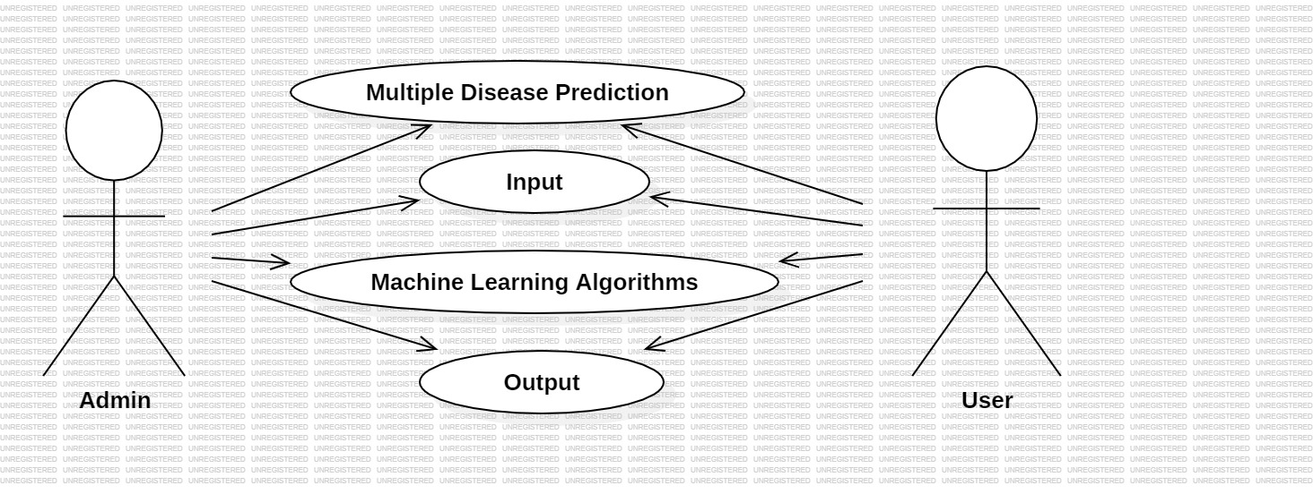
Use Case Diagram
The use case diagram illustrates the various actions that a user can perform in the disease prediction system. The user can enter symptoms and patient details, train the model, request disease prediction, and view the predicted disease

Slide 18
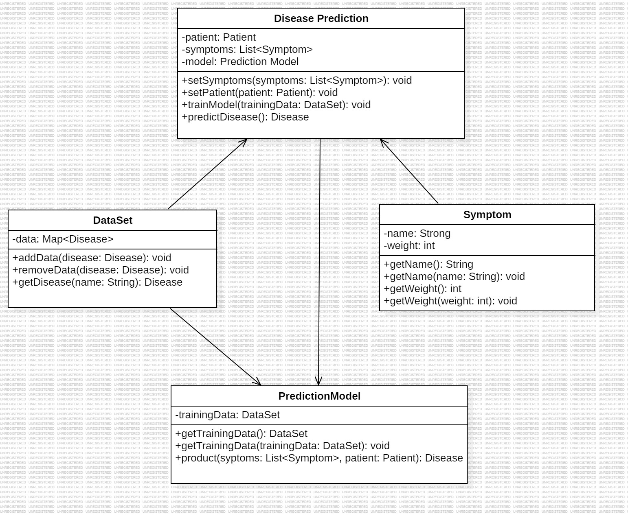
Class Diagram
Class diagram represents the overall disease prediction system. It has attributes such as symptoms (a list of symptoms), patient (patient information), and model (a prediction model). It also has methods to set the symptoms, set the patient information, train the prediction model, and predict the disease.

Slide 19
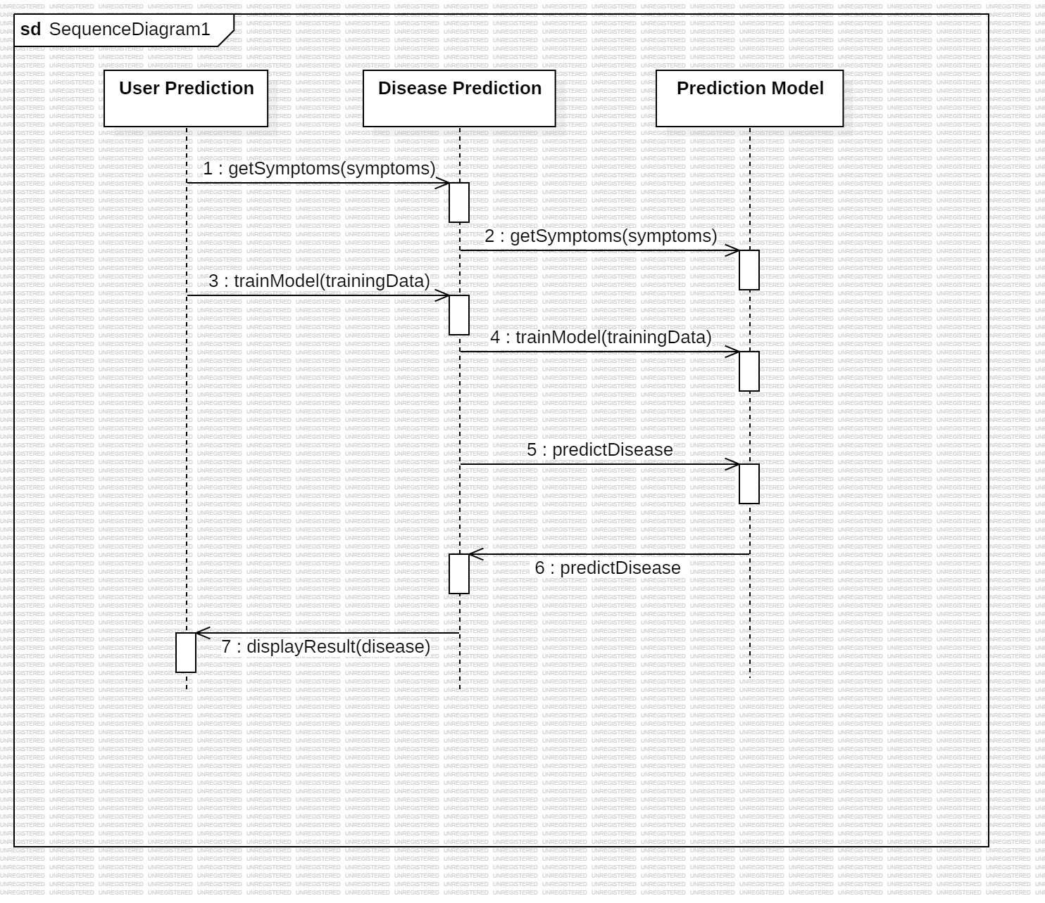
Sequence Diagram
Sequence diagram illustrates the flow of the messages and interactions between the components involved in the disease prediction process, from setting symptoms and patient information to training the model and predicting the disease.

Slide 20
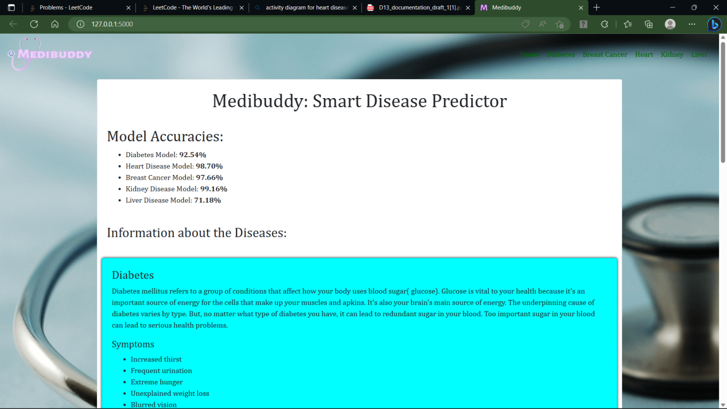
Home Page
The Actual Website that shows details about multiple disease, the web page includes details about the disease and symptoms related to disease.

Slide 21
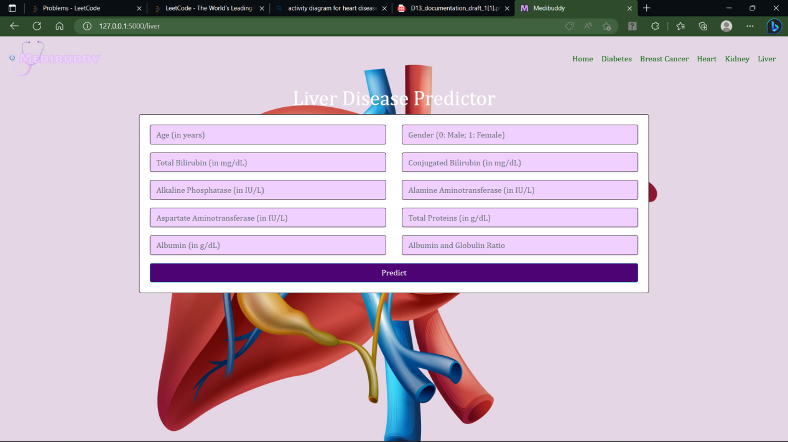
Liver Disease Prediction
The Figure Represents Liver Web Page where user have to enter the values in the text boxes. The user has to enter detailed values in the text boxes, the user then clicked predict to get the results. It Will Redirect To The results page.

Slide 22
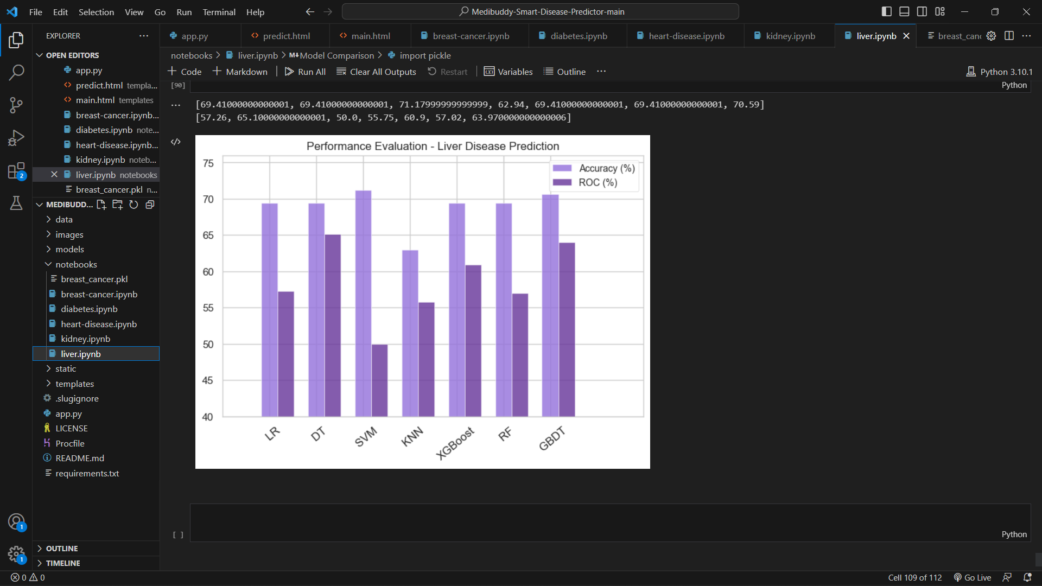
It represents the accuracy of Liver prediction model performed, given by ROC curve, among all the models SVM gave an accuracy of 71%.

Slide 23
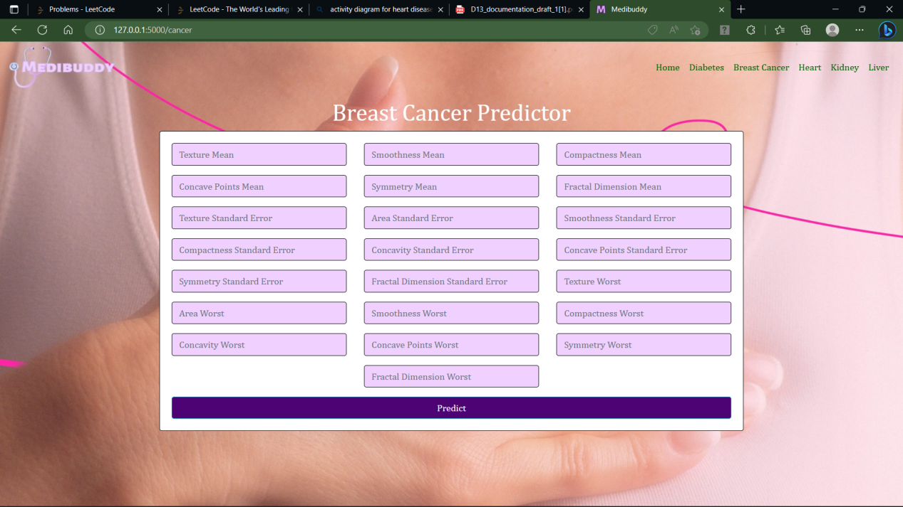
Breast Cancer Prediction
The fig represents breast cancer web page where user have to enter values in the text boxes.The user has to enter detailed values in the text boxes, the user then clicked predict to get the results. It will redirect to result page.

Slide 24
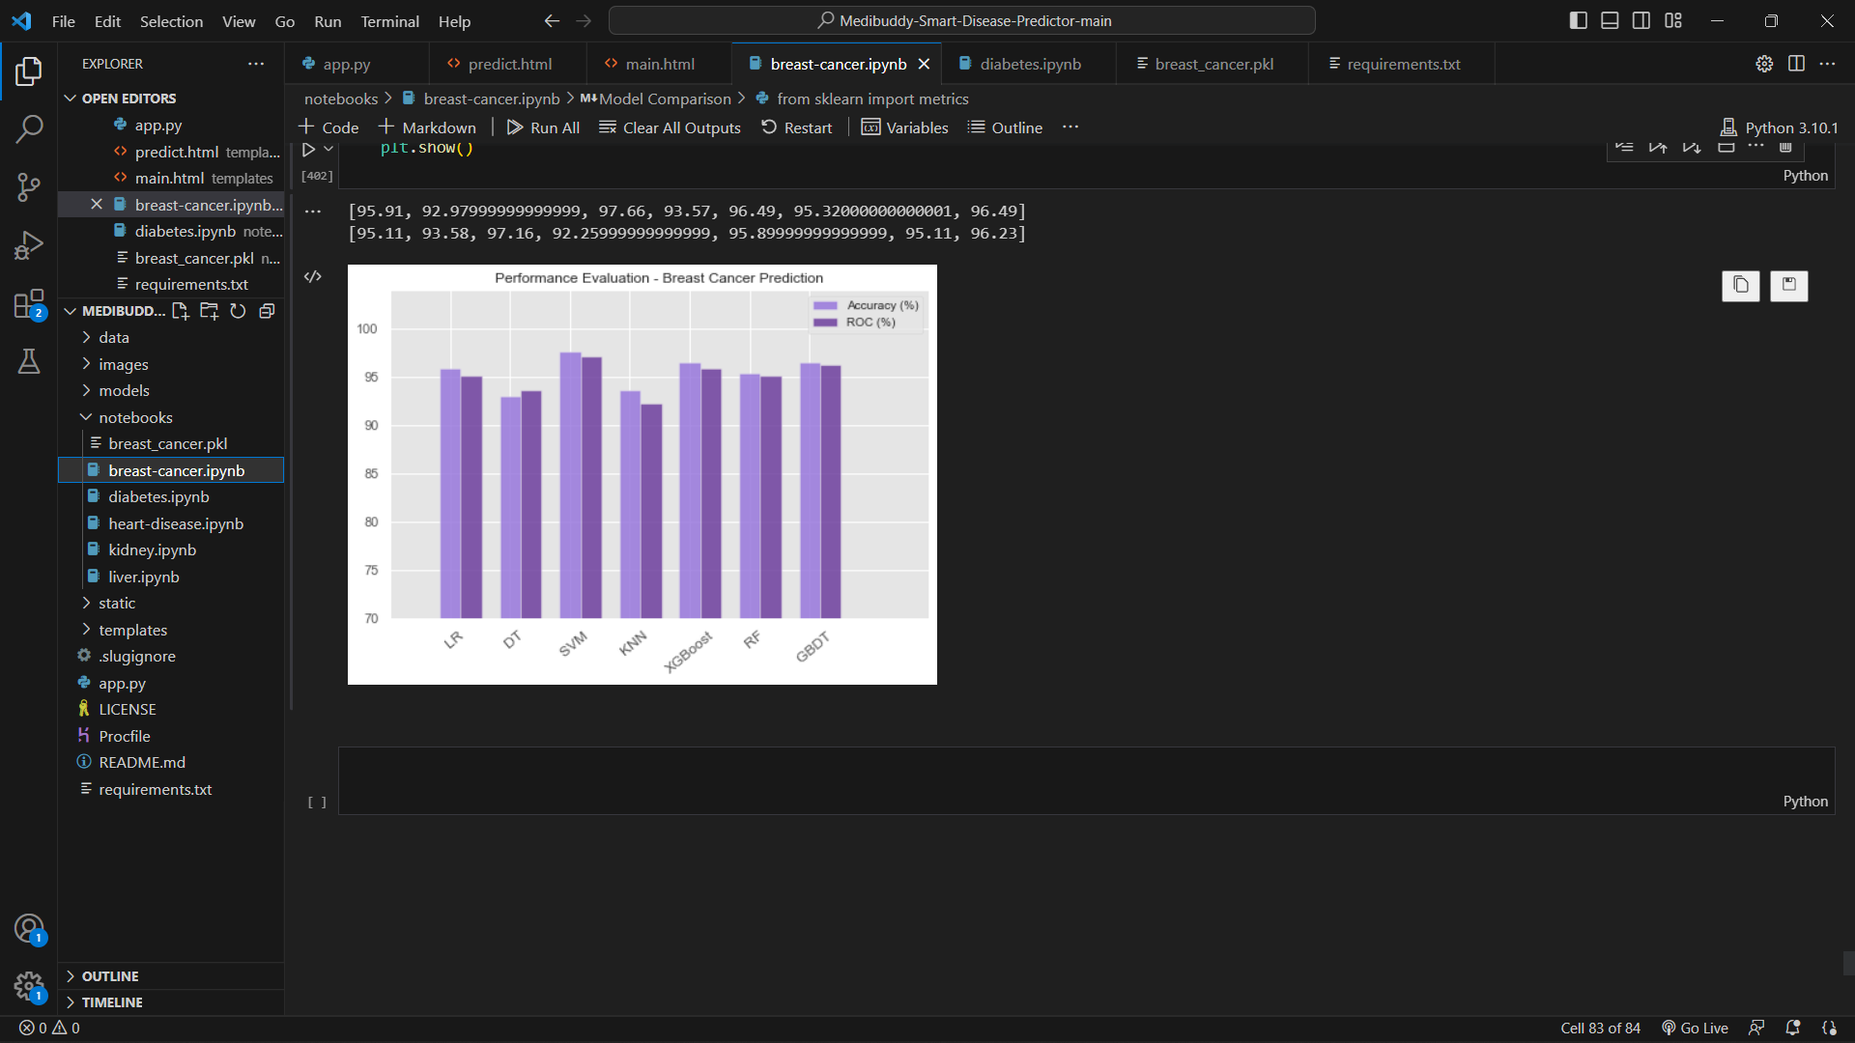
The accuracy of Heart prediction model performed is given by ROC curve, among all the models SVM gave an accuracy of 97%.

Slide 25
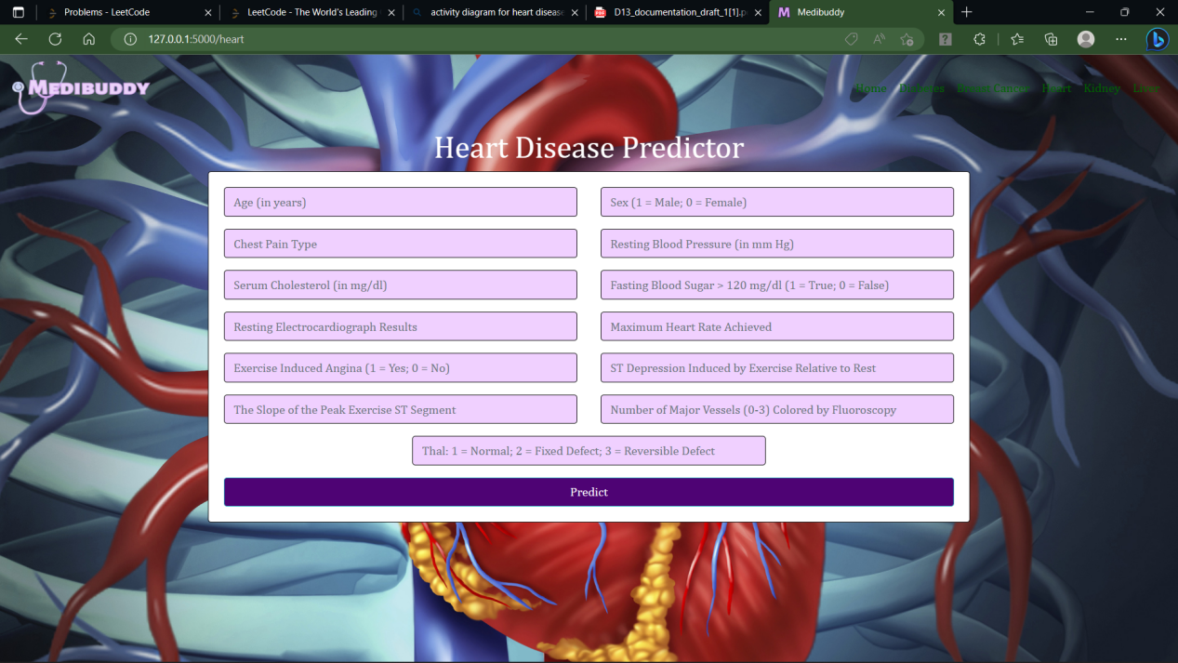
Heart Disease Prediction
The fig represents heart disease web page where user have to enter values in the text boxes.The user has to enter detailed values in the text boxes, the user then clicked predict to get the results. It will redirect to result page.

Slide 26
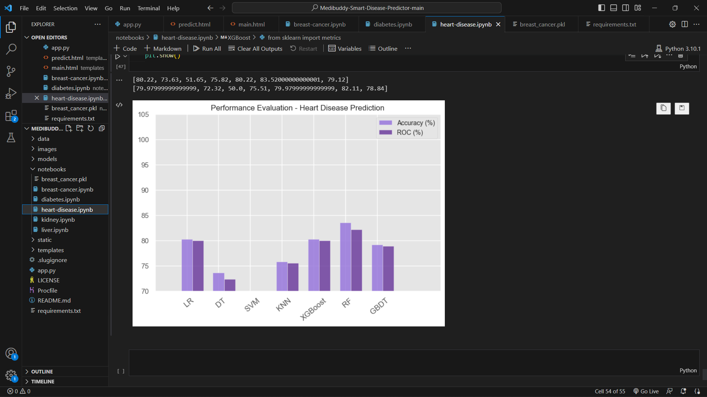
The accuracy of Heart prediction model performed is given by ROC curve, among all the models Random Forest gave an accuracy of 98%.

Slide 27
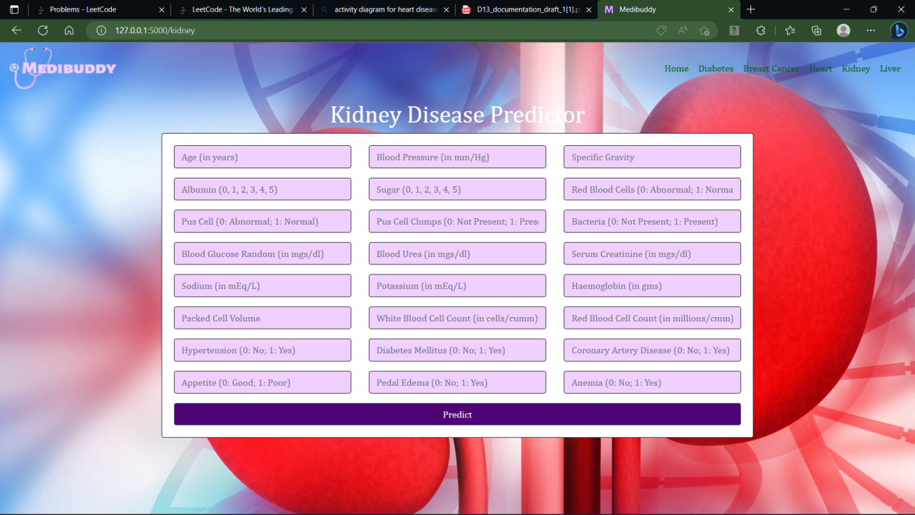
Kidney Disease Prediction
The fig represents kidney web page where user have to enter values in the text boxes.The user has to enter detailed values in the text boxes, the user then clicked predict to get the results. It will redirect to result page.

Slide 28
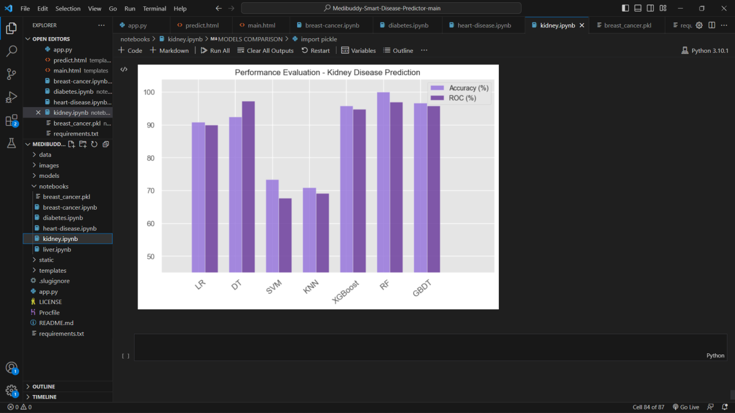
It represents the accuracy of Liver prediction model performed, given by ROC curve, among all the models RF gave an accuracy of 100%.

Slide 29
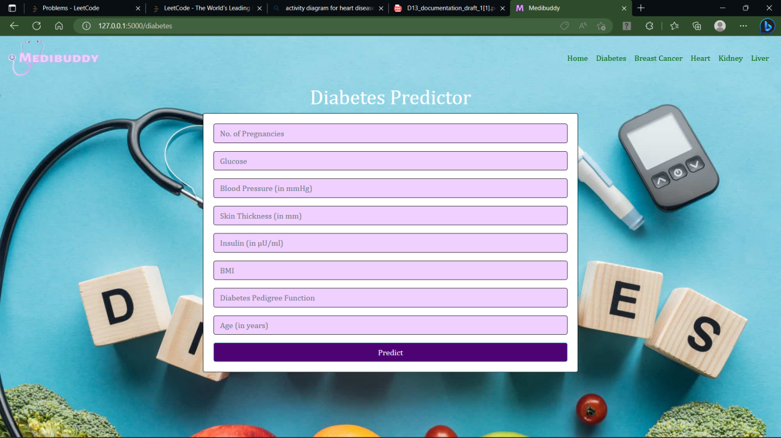
Diabetes Prediction
The fig represents diabetics web page where user have to enter values in the text boxes.The user has to enter detailed values in the text boxes, the user then clicked predict to get the results. It will redirect to result page.

Slide 30
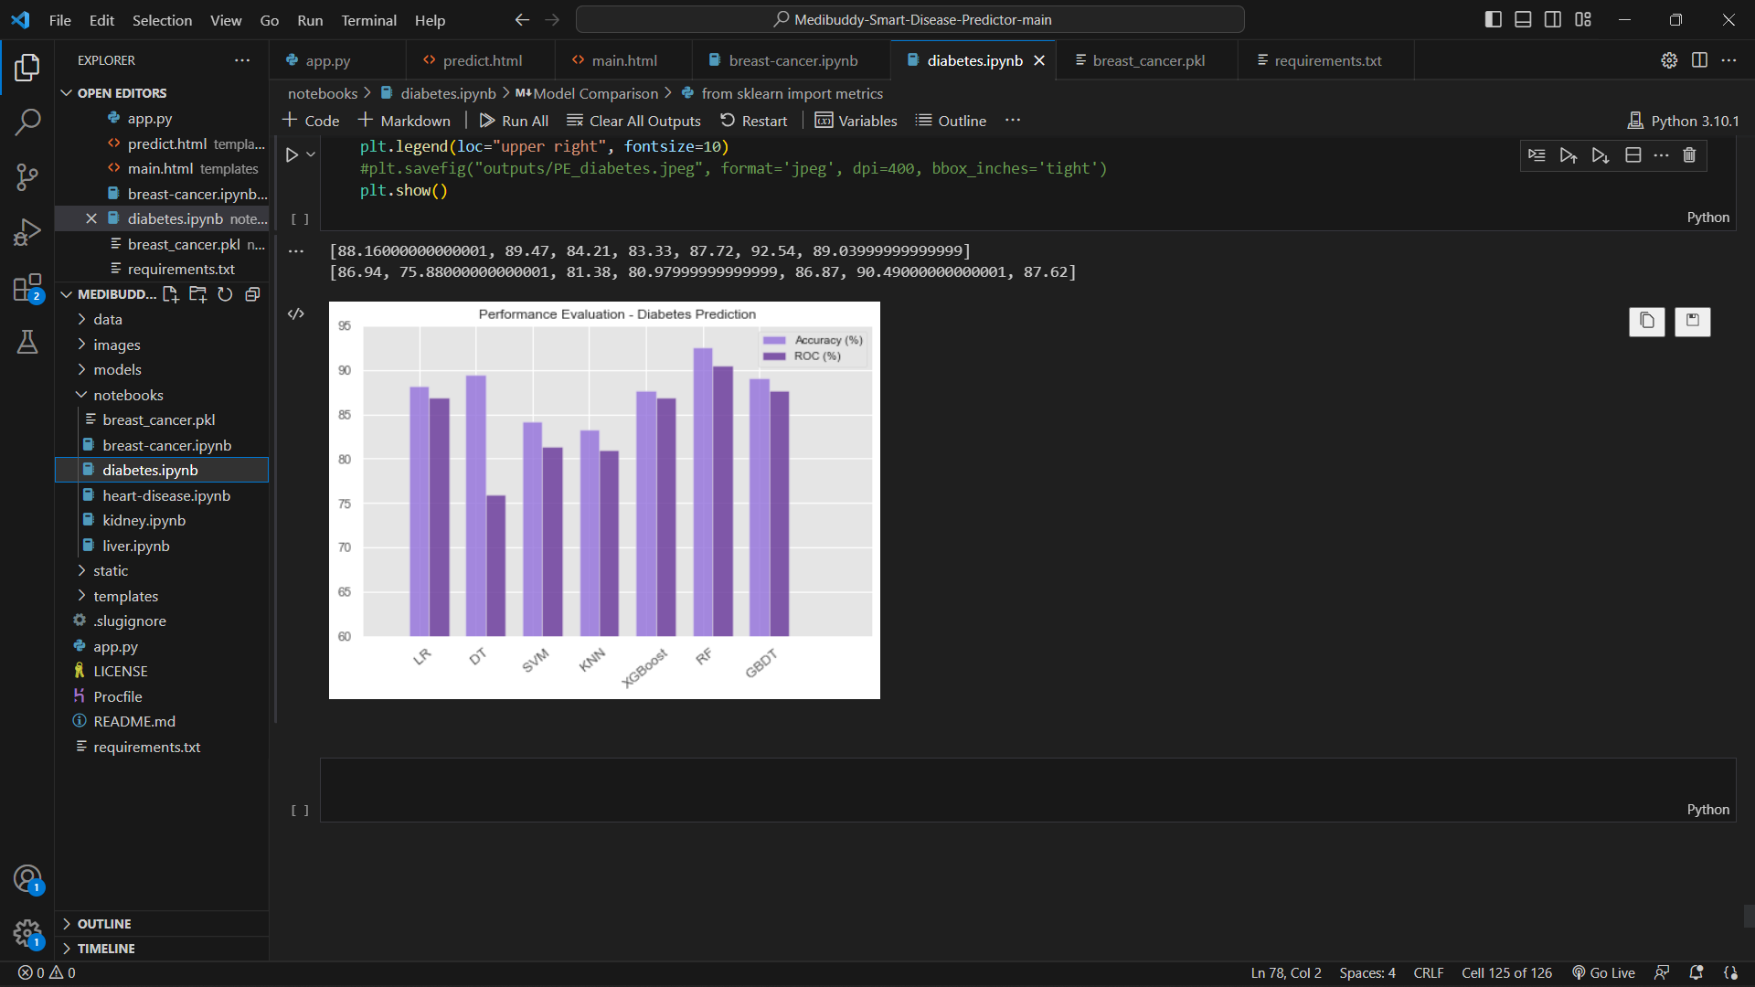
The accuracy of Diabetics prediction model performed is given by ROC curve, among all the models Random Forest gave an accuracy of 93%.

Slide 31
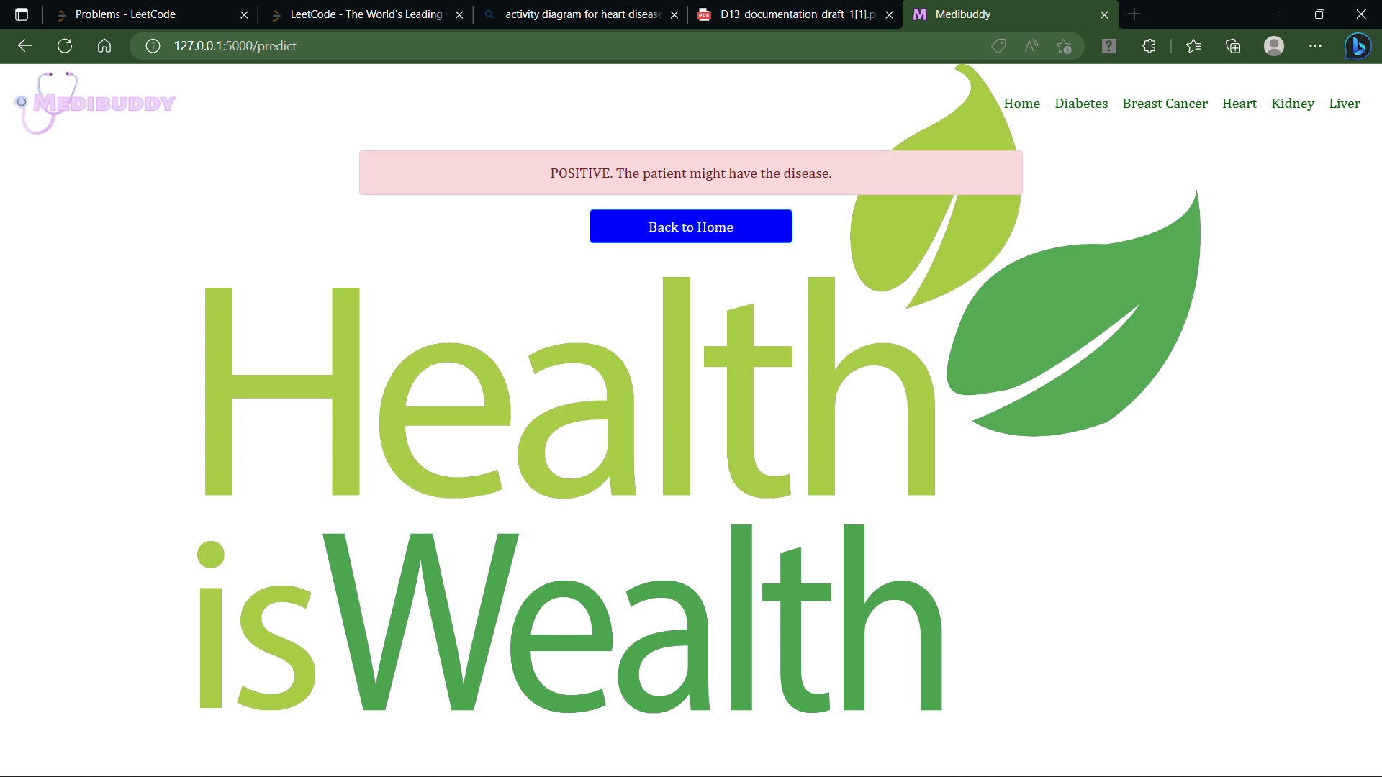
Result Page
The fig represents results web page where user will get the results if the user is facing any problem then the result page will display positive, the patient may be facing disease, else negative the patient is safe and also displays home button below.

Slide 32
Conclusion
The primary objective of this project is to accurately predict diseases based on patient-reported symptoms by implementing Machine Learning algorithms.
In this study, four Machine Learning algorithms were utilized, achieving a mean accuracy of over 95%. This signifies significant improvement and higher accuracy compared to previous works, making the system more reliable and satisfying for users.
Additionally , this system is user-friendly and accessible to a wide range of users without any specific threshold.

Slide 33
References
In a research paper titled "Disease Prediction System," authored by Khurana, S., Jain, A., Kataria, S., Bhasin, K., Arora, S., and Gupta, A.D., published in the International Research Journal of Engineering and Technology in 2019, the authors discuss a system for predicting diseases. The paper is found in Volume 6, Issue 5, with page numbers 5178-5184.
In a paper titled "Heart Disease Prediction with Machine Learning Approaches," Kamboj (2020) explores the use of machine learning techniques for predicting heart disease. The research was published in the International Journal of Science and Research, Volume 9, Issue 7, with pages 1454-1458.
Ware, Rakesh, and Choudhary (2020) present a study on heart attack prediction using machine learning techniques. The research was published in the International Journal of Recent Technology and Engineering, Volume 8, Issue 5, with pages 1577-1580. Additionally, it was also featured in the Turkish Journal of Computer and Mathematics Education, Research Article Vol.12 No.6 (2021), with pages 4013-4023.

